Slide 1
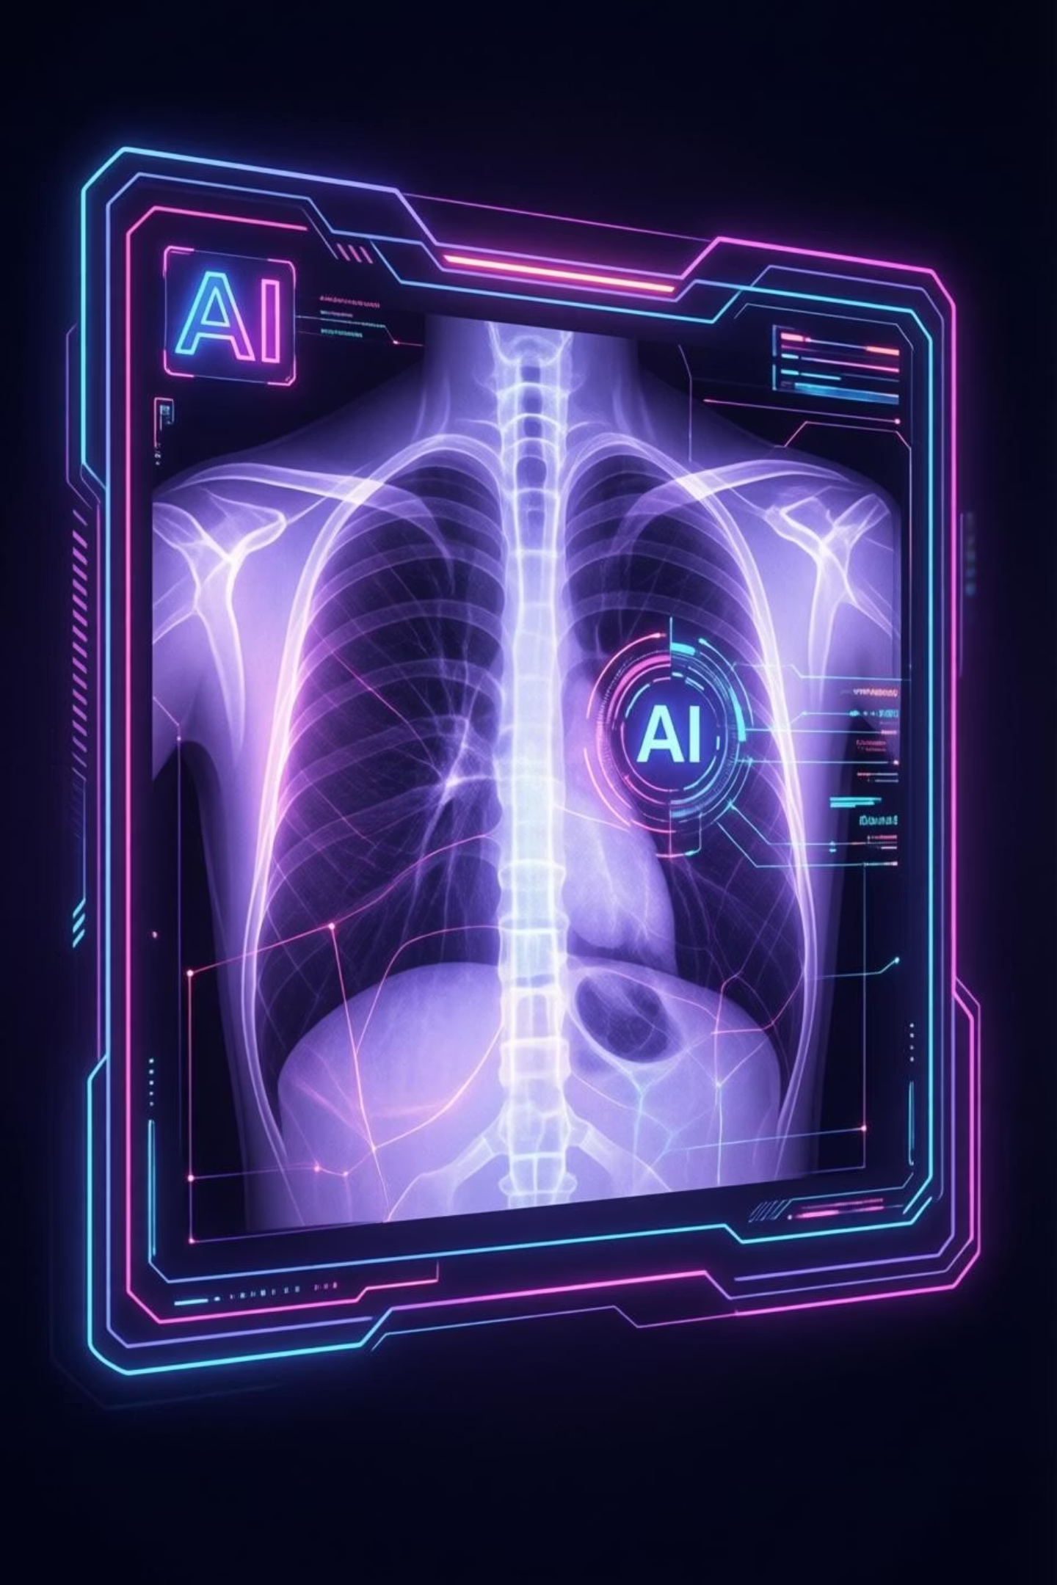
AI-Based Pneumonia Diagnosis from Chest X-Ray Images Using Deep Learning
Course: MS-AI | Subject: Machine Learning
Instructor: Sir Talha Nadeem | Student: Adeel Rehan | Semester: Fall 2025

Slide 2
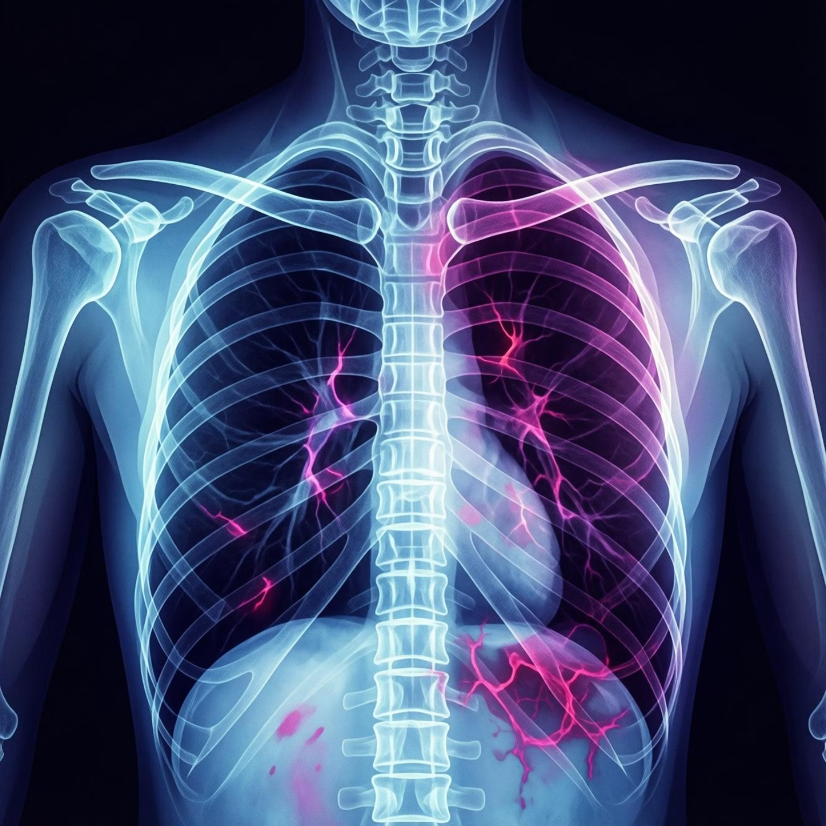
The Challenge: Pneumonia Diagnosis
Pneumonia is a serious respiratory infection, often diagnosed using chest X-rays.
Manual diagnosis is:
Time-consuming
Dependent on expert radiologists
Prone to human error
Our motivation: Develop an AI-based diagnostic support system for early and accurate pneumonia detection.

Slide 3


Project Objectives & Global Impact
1
2
3
Build a Custom CNN
Classify Chest X-Rays
Implement Full Workflow
Develop a Convolutional Neural Network from scratch, without pretrained models.
Categorize images into 'Normal' or 'Pneumonia'.
Cover training, evaluation, and inference using clinically meaningful metrics.
SDG Alignment: Good Health & Well-Being
This project supports SDG-3 by enhancing early disease detection and healthcare efficiency.

Slide 4

Dataset Overview: The Foundation of Our AI
Source
Public chest X-ray dataset from Kaggle.
Total Images
800 images: 400 Normal, 400 Pneumonia.
Image Type
Grayscale X-ray images.
Balance & Split
Balanced dataset to reduce bias, with stratified train, validation, and test splits.

Slide 5





Methodology: Our Deep Learning Pipeline
Data Ingestion & Preprocessing
Image Resizing & Normalization
Custom CNN Architecture Design
Model Training from Scratch
Evaluation & Inference
This end-to-end deep learning workflow is fully compliant with course rules.

Slide 6


Model Architecture & Training Setup
CNN Architecture
Training Setup
Convolution layers: Feature extraction
Optimizer: Adam
Pooling layers: Dimensionality reduction
Loss: Binary Cross-Entropy
Dropout: Regularization
Epochs: 10
Fully connected layers: Classification
Batch size: 32

Slide 7

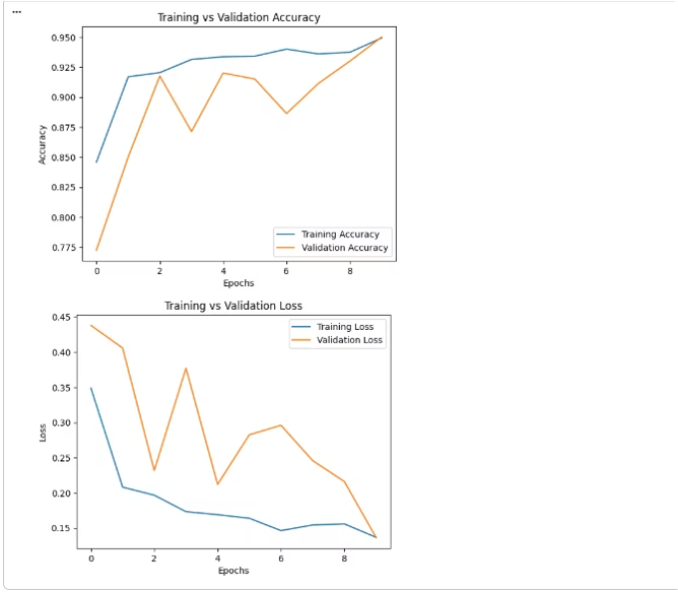
Training Results: Stable Convergence
Observations from the training graphs:
Stable convergence was achieved.
Validation metrics closely followed training metrics.
No severe overfitting was observed, indicating a robust model.

Slide 8

Evaluation Metrics: High Performance
Accuracy
95%
Precision (Pneumonia)
0.93
Recall (Pneumonia)
0.98
F1-Score
0.95
Key Insight: High recall is critical to avoid missing pneumonia cases, ensuring patient safety.

Slide 9
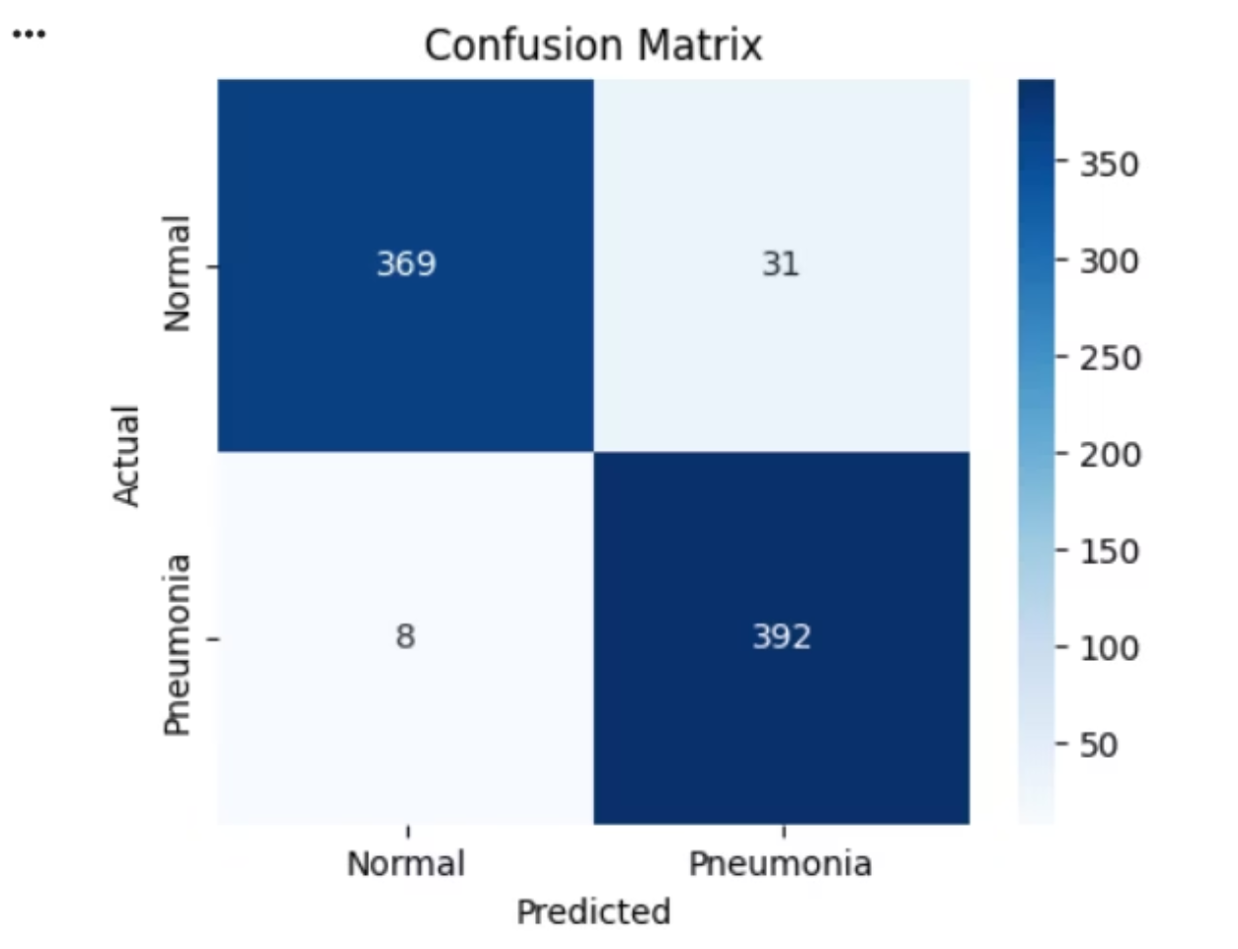

Confusion Matrix & Inference: Reliable Diagnosis
Confusion Matrix
Inference
Load trained CNN model.
Input a single chest X-ray image.
Output: Normal / Pneumonia with a confidence score.
\[\[369 31\]
\[ 8 392\]\]
Very low false negatives, making the model reliable for medical diagnosis.

Slide 10

Limitations, Future Work & Conclusion
Limitations
Future Work
Binary classification only.
Multi-class lung disease detection.
Limited dataset size.
No clinical validation yet.
Utilize larger datasets.
Integrate Explainable AI (Grad-CAM).
Conclusion
CNN built entirely from scratch.
Achieved 95% accuracy.
Meets all academic and project requirements.

